Slide 1
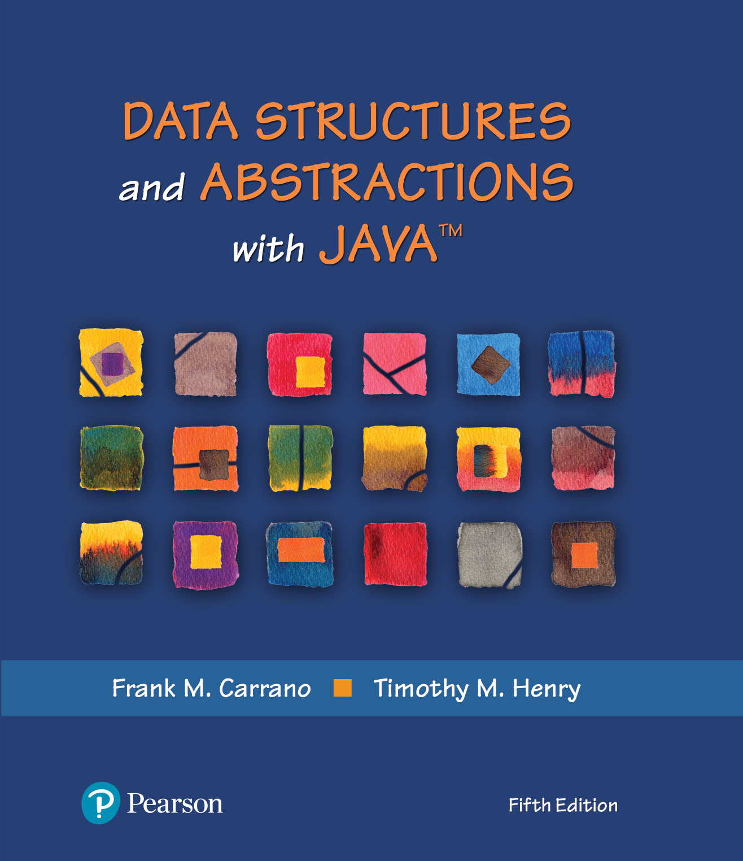
Module 5
Chapter 3 - A Bag
Implementation
that Links Data

Slide 2
Video Notes
Linked Data
https://mediaplayer.pearsoncmg.com/assets/secs-vn-ch03a-linked-data
The Linked List
https://mediaplayer.pearsoncmg.com/assets/secs-vn-ch03b-the-linked-list
Completing Linked List
https://mediaplayer.pearsoncmg.com/assets/secs-vn-ch03c-completing-linked-list
Notes:
To maximize your learning experience, prepare for class prior each week

Slide 3
Array Implementation Challenges
Array has fixed size
May become full
Resizing is possible but requires overhead of time
Alternatively may have wasted space

Slide 4
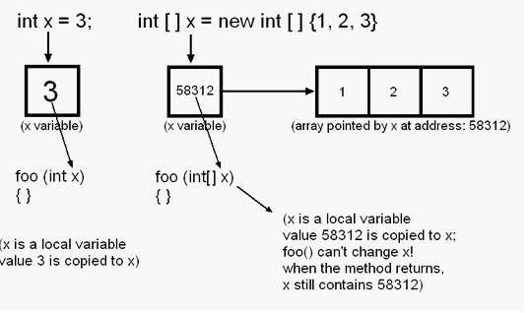
Variables vs. Reference Variables
Variable vs. Reference Variable
My Array
0
1
2
3
4
5
6
7
8
Notes:
What is a reference variable
Logic view vs. physical view

Slide 5
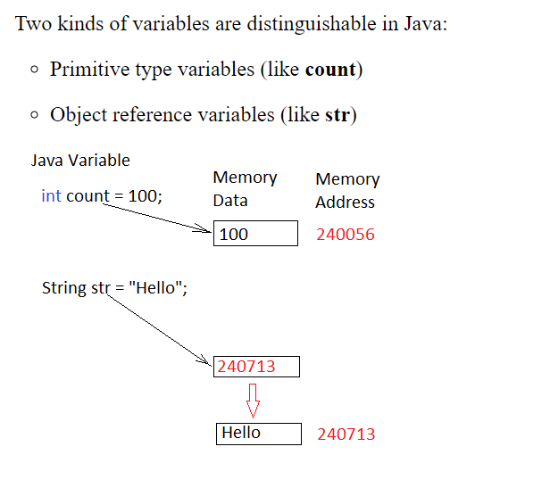
Variables vs. Reference Variables
Notes:
What is a reference variable
Logic view vs. physical view

Slide 6
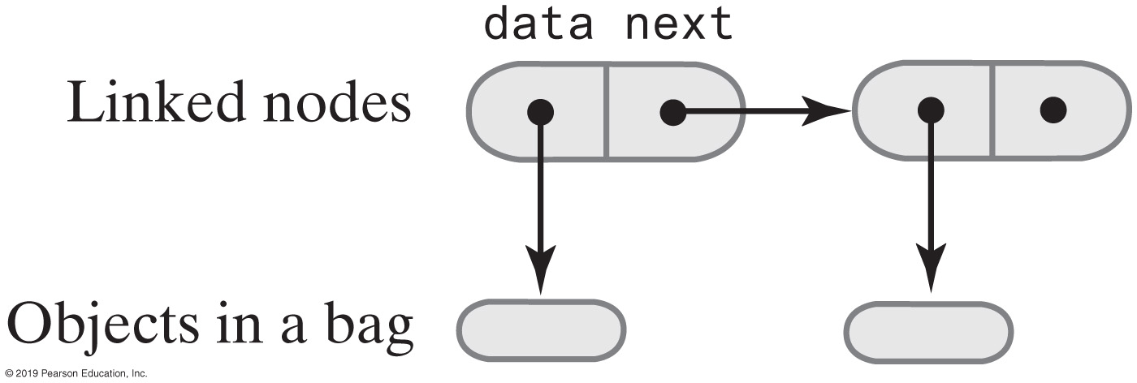
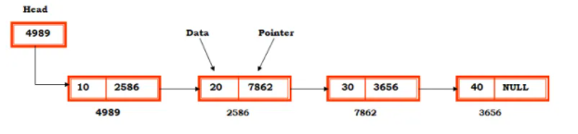
Linked Nodes
Noncontiguous dynamic structures
Expand and contrast at runtime during every Insert/Delete operation
Memory frugal
Never assigned more memory than they need
Notes:
What is a reference variable
Logic view vs. physical view

Slide 7
Noncontiguous Structures
Do not require contiguous (sequential) memory
Client needs not specify the maximum number of nodes to be stored in the structure
They can utilize fragmented memory
Unused memory
Fragmented RAM Memory
Application A
20 Kbytes
Unused
Application B
20 Kbytes
Unused
Application C
20 Kbytes
Unused

Slide 8
Linked Data Characteristics
Linked Data
Every node has a field that is a node reference, called a link field
Every node’s address is stored in at least one other node (except perhaps the unique first node)
The link fields locate and order the nodes

Slide 9
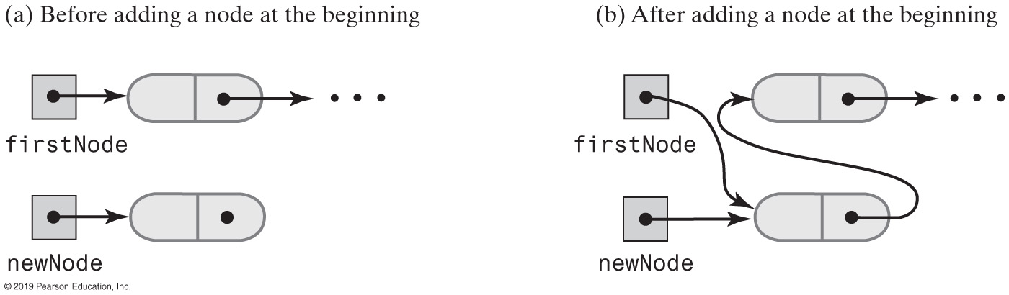
Beginning a Chain of Nodes
Adding a new node
Where should the new node being added?
Notes:
Benefit of adding it to the beginning of a chain
What about adding it to the end of the chain?

Slide 10
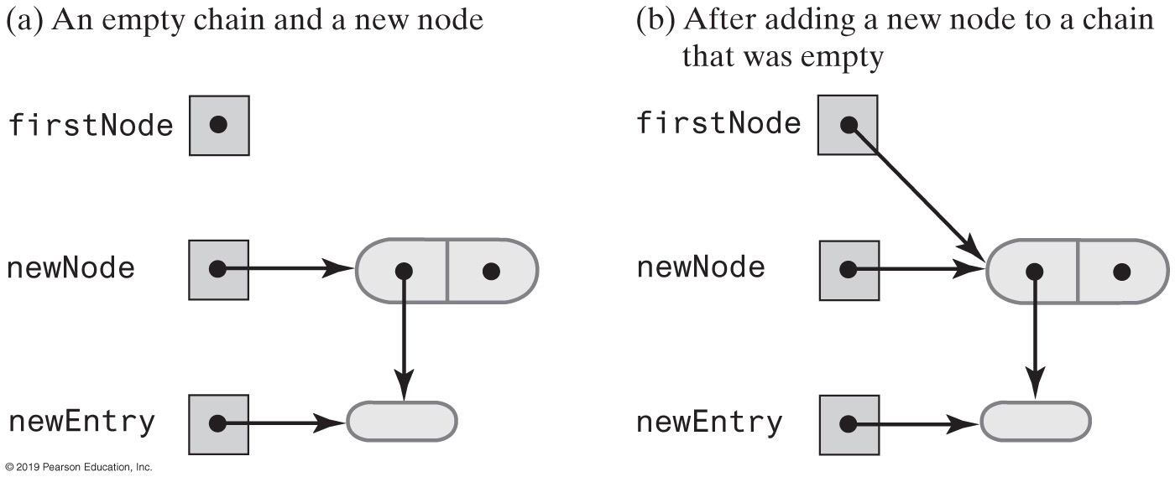
Beginning a Chain of Nodes
Notes:
Adding a new node to a brand new (blank) linked list
Why is a newEntry needed?

Slide 11

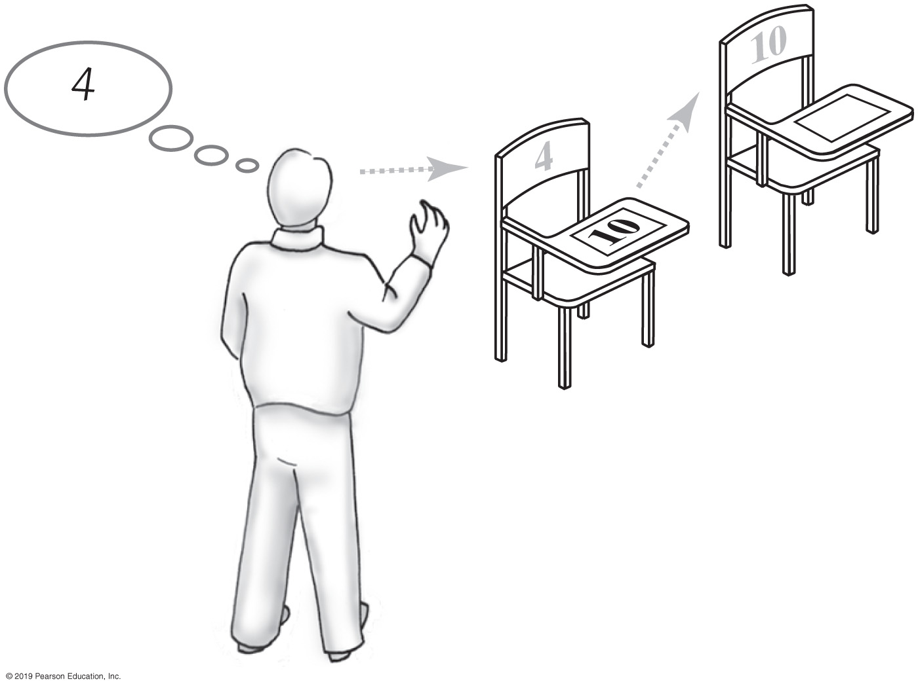
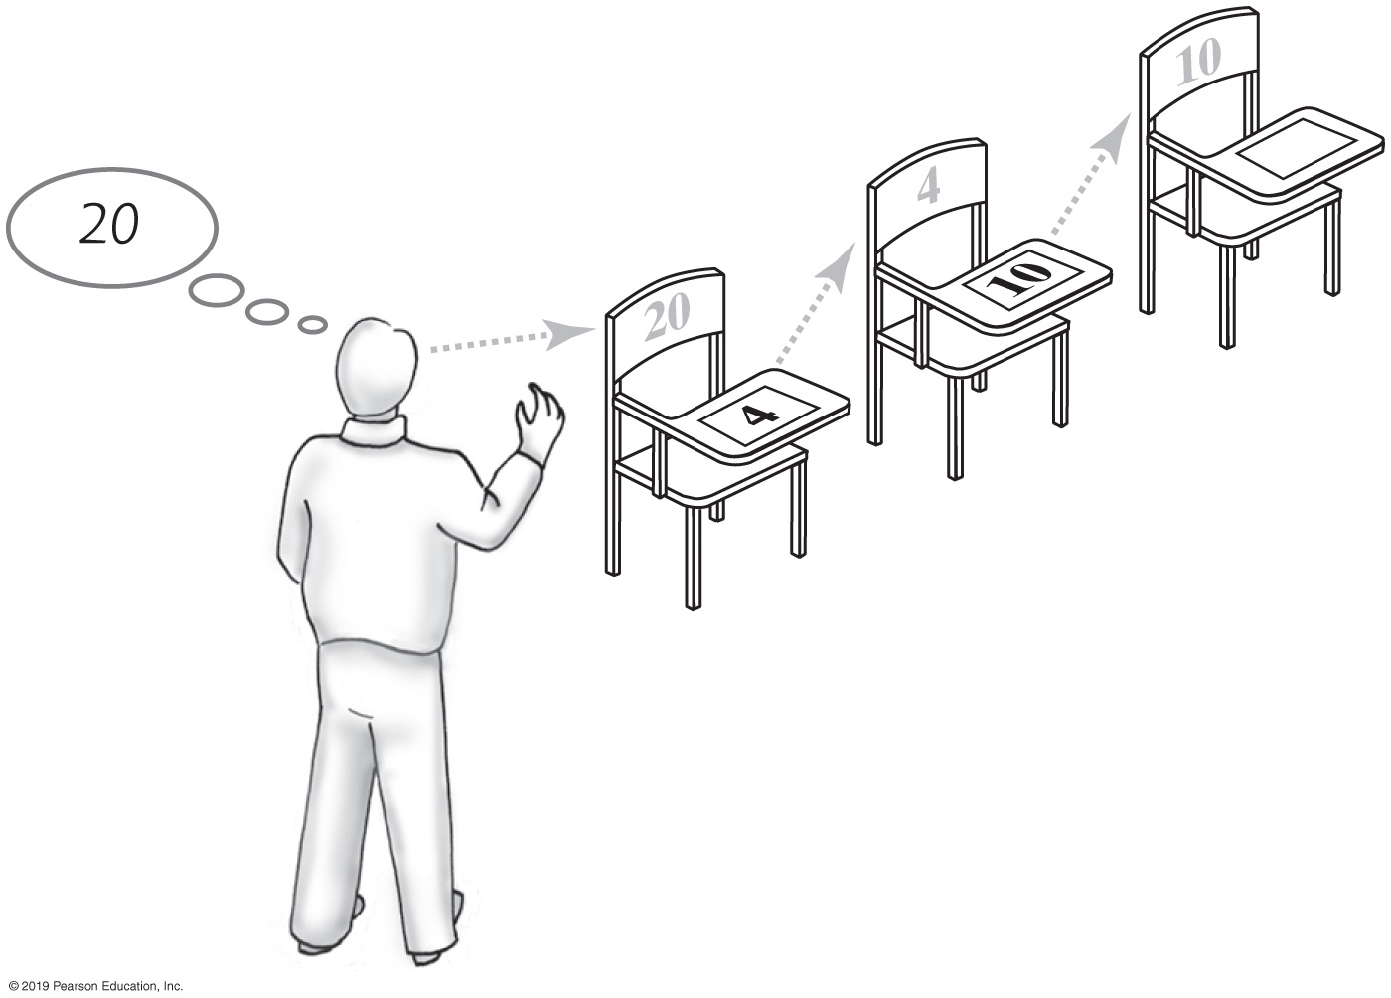
Forming a Chain by Adding to Its Beginning
FIGURE 3-2
One desk in the room
FIGURE 3-3
Two linked desks, with the newest desk first
FIGURE 3-4 Three linked desks, with the newest desk first
Notes:
When adding an entry to a LinkedBag, we can add it to anywhere (positions.) However, it’s easiest to add it to the beginning

Slide 12
The Private Class Node
private class Node
{
private T data; // Entry in bag
private Node next; // Link to next node
private Node(T dataPortion)
{
this(dataPortion, null);
} // end constructor
private Node(T dataPortion, Node nextNode)
{
data = dataPortion;
next = nextNode;
} // end constructor
} // end Node
Two linked nodes that each reference object data
Notes:
A node is the unit that we are declaring. It’s used to store one element
For this example (only,) class Node is private because it’s going to be a nested class within another class
It does not have to be this way

Slide 13
Class LinkedBag (1 of 2)
/** OUTLINE
A class of bags whose entries are stored in a chain of linked nodes.
The bag is never full. */
public class LinkedBag<T> implements BagInterface<T>
{
private Node firstNode; // reference to first node
private int numberOfEntries;
public LinkedBag()
{
firstNode = null;
numberOfEntries = 0;
} // end default constructor
// . . .
Notes:
BagInterface specifies what a bag is
Class LinkedBag is an actual implementation of a bag using linked list (to do so)
Watch the corresponding video note

Slide 14
Class LinkedBag (2 of 2)
private class Node
{
private T data; // Entry in bag
private Node next; // Link to next node
private Node(T dataPortion)
{
this(dataPortion, null);
} // end constructor
private Node(T dataPortion, Node nextNode)
{
data = dataPortion;
next = nextNode;
} // end constructor
} // end Node
} // end LinkedBag
Nested Classes | https://docs.oracle.com/javase/tutorial/java/javaOO/nested.html
Notes:
The Node class is nested inside the LinkedBag class
Why?

Slide 15
Beginning a Chain of Nodes
/** Adds a new entry to this bag.
@param newEntry The object to be added as a new entry.
@return True. */
public boolean add(T newEntry) // OutOfMemoryError possible
{
// Add to beginning of chain:
Node newNode = new Node(newEntry);
newNode.next = firstNode; // Make new node reference rest of chain
// (firstNode is null if chain is empty)
firstNode = newNode; // New node is at beginning of chain
numberOfEntries++;
return true;
} // end add
Notes:
This is how we add a new entry to a linkedbag

Slide 16
Method toArray
/** Retrieves all entries that are in this bag.
@return A newly allocated array of all the entries in the bag. */
public T[] toArray()
{
// The cast is safe because the new array contains null entries
@SuppressWarnings("unchecked")
T[] result = (T[])new Object[numberOfEntries]; // Unchecked cast
int index = 0;
Node currentNode = firstNode;
while ((index < numberOfEntries) && (currentNode != null))
{
result[index] = currentNode.data;
index++;
currentNode = currentNode.next;
} // end while
return result;
} // end toArray

Slide 17
Test Program
/** A test of the methods add, toArray, isEmpty, and getCurrentSize,
as defined in the first draft of the class LinkedBag. */
public class LinkedBagDemo1
{
public static void main(String[] args)
{
System.out.println("Creating an empty bag.");
BagInterface<String> aBag = new LinkedBag1<>();
testIsEmpty(aBag, true);
displayBag(aBag);
String[] contentsOfBag = {"A", "D", "B", "A", "C", "A", "D"};
testAdd(aBag, contentsOfBag);
testIsEmpty(aBag, false);
} // end main
Notes:
Each student should complete the LinkedBag class and test it using the provided test program
Same test program can be used to test both the ArrayBag and LinkedBag

Slide 18
Method getFrequencyOf
/** Counts the number of times a given entry appears in this bag.
@param anEntry The entry to be counted.
@return The number of times anEntry appears in the bag. */
public int getFrequencyOf(T anEntry)
{
int frequency = 0;
int loopCounter = 0;
Node currentNode = firstNode;
while ((loopCounter < numberOfEntries) && (currentNode != null))
{
if (anEntry.equals(currentNode.data))
{
frequency++;
} // end if
loopCounter++;
currentNode = currentNode.next;
} // end while
return frequency;
} // end getFrequencyOf

Slide 19
Method contains
/** Tests whether this bag contains a given entry.
@param anEntry The entry to locate.
@return True if the bag contains anEntry, or false otherwise */
public boolean contains(T anEntry)
{
boolean found = false;
Node currentNode = firstNode;
while (!found && (currentNode != null))
{
if (anEntry.equals(currentNode.data))
found = true;
else
currentNode = currentNode.next;
} // end while
return found;
} // end contains

Slide 20
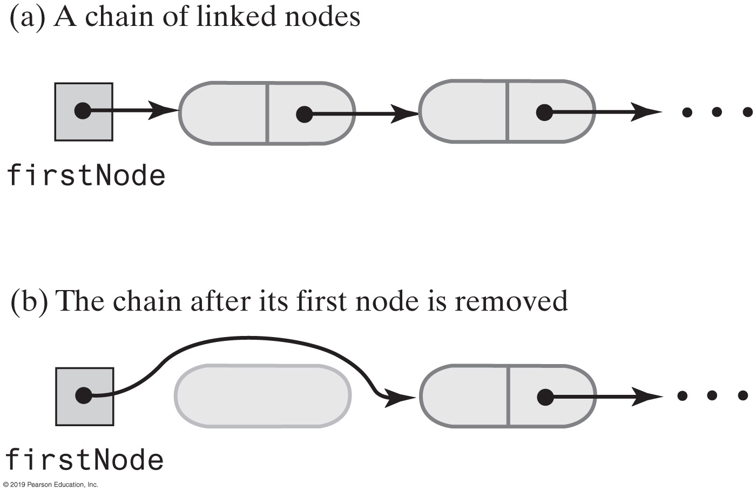
Removing an Item
A chain of nodes just before and just after its first node is removed
Notes:
Why should we simply remove the first node?

Slide 21
Method remove
/** Removes one unspecified entry from this bag, if possible.
@return Either the removed entry,
if the removal was successful, or null */
public T remove()
{
T result = null;
if (firstNode != null)
{
result = firstNode.data;
firstNode = firstNode.next; // Remove first node from chain
numberOfEntries--;
} // end if
return result;
} // end remove
Notes:
Here is the logic to do so

Slide 22
Method remove
// Locates a given entry within this bag.
// Returns a reference to the node containing the entry, if located,
// or null otherwise.
private Node getReferenceTo(T anEntry)
{
boolean found = false;
Node currentNode = firstNode;
while (!found && (currentNode != null))
{
if (anEntry.equals(currentNode.data))
found = true;
else
currentNode = currentNode.next;
} // end while
return currentNode;
} // end getReferenceTo

Slide 23
Using a Chain (Linked Data)
Pros
Bag can grow and shrink in size as necessary.
Remove and recycle nodes that are no longer needed
Adding new entry to end of array or to beginning of chain both relatively simple
Similar for removal
Cons
Removing specific entry requires search of chain
Chain requires more memory than array of same length
Notes:
Why does a chain require more memory?

Slide 24
Activity | Tutorials
An Introduction to Linked Lists for Dummies
https://medium.com/@mahdhirezvi/an-introduction-to-linked-lists-for-dummies-1b45d2e7b36e
Implementing Linked Lists with Java
https://medium.com/swlh/implementing-linked-lists-with-java-25a4a708b5fc
Complete the tutorial
Notes:
Complete the LinkedBag class and test it against the provided test code

Slide 25
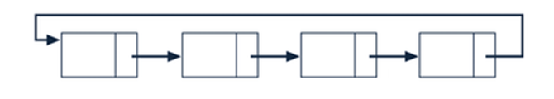
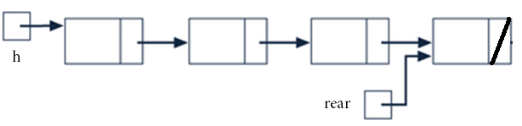
Other Types of Linked Lists
Singly linked variations
Circular
The last node references the dummy node
Double-Ended
A reference variable references the last node
Sorted
Nodes are stored in key field sorted order
25
25
25

Slide 26
Sorted Singly Linked List Algorithms
Same as Singly Linked list except
The add algorithm is modified
Uses a binary search to find insertion point
Search continues until a node is found whose key is greater than the new node’s key, or the last node is found
In the remove algorithm
The sequential search Boolean condition is expanded to halt when a node is found whose key is greater than the given key
Halt on expanded condition means key not found
Notes:
It’s not easy to perform binary search for a linked list

Slide 27
Circular Singly Linked List
l
next
firstNode
null
180
200
l
next
l
next
l
next
l
next
649
300
20
54
973
5
332
200
180
300
54
5
T’s key
info
X’s key
info
G’s key
info
B’s key
info
649
20
973
332

Slide 28
LinkedList<E> (Java Standard Library)
LinkedList is a doubly linked list
Class stores two links:
One to the next element, and
One to the previous element
To move the list position backwards, use:
hasPrevious
previous

Slide 29
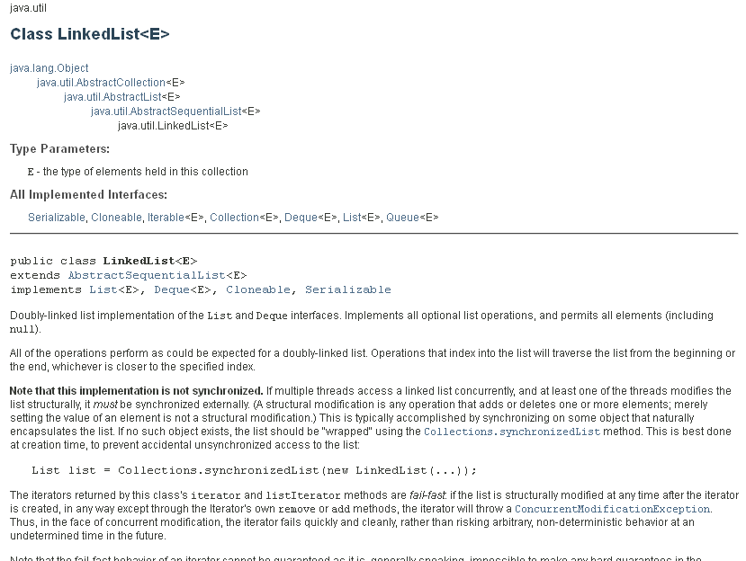

Slide 30
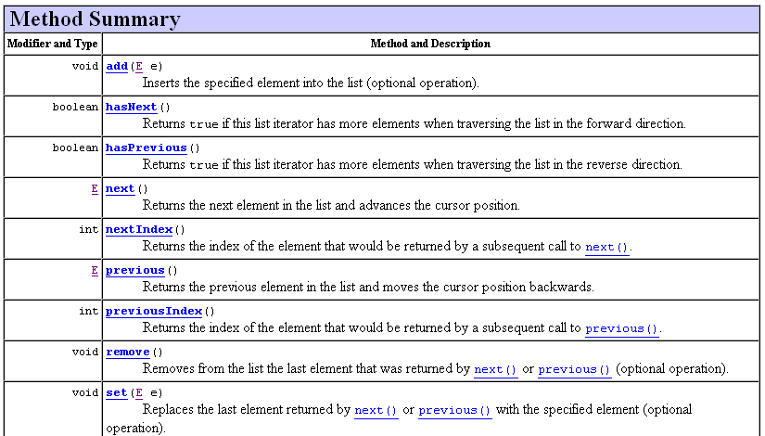
LinkedList<E>

Slide 31
Linked List as an Array of Records
nodes
.info
.next
list
free
0
1
[0]
[1]
[2]
[3]
[4]
[5]
[6]
[7]
[8]
[9]
4
5
6
8
7
3
-1
2
9
-1
David
Miriam
Joshua
Robert
Leah
An array with a linked list of values and free space
Notes:
Why? Next Slide
list tells us the starting point
free tells us where to add new node to next
First node (of list) is David

Slide 32
Linked List as an Array of Records
Why?
If we want to write (save) the nodes to a file for the next time we run the program, references (pointer addresses) are meaningless after the execution of a program. An index, however remains valid on the next run of the program once it’s loaded from a file
Perhaps dynamic allocation is too costly (runtime allocation of each node individually)
Some programming languages do not support dynamic allocation or pointer types. Can still use linked structures, but pointer values are represented as array indexes (hhis is not as critical nowadays)

Slide 33
nodes
.info
.next
[0]
[1]
[2]
[3]
[4]
[5]
[6]
[7]
[8]
[9]
4
5
6
8
7
3
-1
2
9
-1
David
list
free
0
1
Miriam
Joshua
Robert
Leah
list
David Joshua Leah Miriam Robert
free
Position 1 Position 5 Position 3 Position 8 Position 9
Notes:
The array of records is representing our linked data

Slide 34
Linked List as an Array of Records
nodes
.info
.next
Before
[0]
[1]
[2]
[3]
[4]
[5]
[6]
[7]
[8]
[9]
4
5
6
8
7
3
-1
2
9
-1
David
list
free
0
1
Miriam
Joshua
Robert
Leah
Let’s add Eric to our linked list
Where should Eric be placed?
What would be the algorithm for adding “Eric”?
Notes:
[1] <- Eric
Free = 5
Eric.next = 0
List = 1

Slide 35
Linked List as an Array of Records
nodes
.info
.next
Add to beginning of list
temp = list
list = free
free = nodes[free].next
nodes[list].info = “Eric”
nodes[list].next = temp
[0]
[1]
[2]
[3]
[4]
[5]
[6]
[7]
[8]
[9]
4
0
6
8
7
3
-1
2
9
-1
David
Eric
Miriam
Joshua
Robert
After
list
free
1
5
Leah
Adding Eric
What’s easier, add to beginning or end of list?

Slide 36
Linked List as an Array of Records
A linked list in static storage
list
protected class NodeType
{
char data;
int next;
};
public class ListType
{
NodeType nodes[5];
int first;
};
ListType list = new ListType();
.nodes
[0]
[1]
[2]
[3]
[4]
C
B
E
A
D
3
4
0
-1
1
2
.first
Notes:
Why are we doing this?
Although it’s not common, we could be working on a system which does NOT support linked list (feature)
For those cases, we would be able to mimic the Linked List using an Array (of Records)
What’s our linked list looked like?
Starting with index 3 (.first tells us so,) we have the following list
A -> B -> C -> D -> E

